Slide 1

Developing Recommendation System based on Sentiment Analysis with Domain-Polarity Adaptation
Unstructured Data Analysis, Spring, 2016
FINAL PRESENTATION
Group 4
Jinwook Choi, Byungdae An, Jeongsan Lee

Slide 2
C
ONTENTS
Introduction
Method
Overall Framework
Data description
Text preprocessing
Domain-Polarity Adaptation
Text postprocessing
Experiments
Experimental settings
Additional Experiment
Conclusions

Slide 3

Introduction
The goals of this project
CF-based Recommendation System using Sentiment Analysis on Reviews
Reviews could have more detailed opinions rather than simple ratings
Generating Sentiment scores from reviews through SA
Using Sentiment scores as proxy of rating in Collaborative-Filtering based RS
Domain-polarity adaptation for Sentiment Analysis
Polarities of each word can be changed depending on Domains
It is better to adapt polarities of words depending on domains than to plainly use general lexical resources like SentiWordNet
Propose the new approach for Recommendation system based on Sentiment analysis with Domain-polarity Adaptation
Notes:
Percetual maps
To show the positions of products in comparison with those of competitors
To display only two dimensions of product features about some products
Radar chart
To display multiple dimensions of the products in one chart
To display a limited number of products in a chart

Slide 4

Overall Framework
Customer Review Data Collection
Text Preprocessing
Reference SentiWordNet
Domain-Polarity Adaptation
Negation & Intensifier treatment
Generate Sentiment scores
User-Based Collaborative Filtering RS
Evaluations
Notes:
Percetual maps
To show the positions of products in comparison with those of competitors
To display only two dimensions of product features about some products
Radar chart
To display multiple dimensions of the products in one chart
To display a limited number of products in a chart

Slide 5
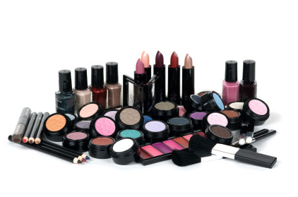
Data Description
Data domain
Makeupalley.com
Beauty product reviews
Data characteristics
# of reviews: 125, 876
# of users: 62,141
# of products: 1,872
Used data for Experiments
184 users who have more than 20 reviews
5,393 reviews
Notes:
Percetual maps
To show the positions of products in comparison with those of competitors
To display only two dimensions of product features about some products
Radar chart
To display multiple dimensions of the products in one chart
To display a limited number of products in a chart

Slide 6

Preprocessing & SentiWordNet
Preprocessing steps
Example
“This product was great! I really loved this product. But I didn't enjoy the perfume of it.”
[[‘great’, ‘JJ’], [‘really’, ‘RB’], [‘love’, ‘VBD’], [“didn’t”, ‘VBP’], [‘enjoy’, ‘VB’]]
SentiWordNet Reference
For calculating sentiment scores of each word
Senti_score(word) = Average(Positive_score) – Average(Negative_score)
Example: [‘love’, ‘VBD’]
Tokenizing
POS tagging
Lemmatization
Stopwords removal
Word, POS | Positive | Negative
love.v.01 | 0.5 | 0.0
love.v.02 | 1.0 | 0.0
love.v.03 | 0.625 | 0.0
sleep_together.v.01 | 0.375 | 0.125
Average | 0.625 | 0.03125
Senti_score | 0.59375
Notes:
Percetual maps
To show the positions of products in comparison with those of competitors
To display only two dimensions of product features about some products
Radar chart
To display multiple dimensions of the products in one chart
To display a limited number of products in a chart

Slide 7

Domain-Polarity Adaptation
Framework
Total Data Set
Positive Set
(rating = 5)
Negative Set
(rating = 1)
The set of Words
The set of Words
Word Matrix
The set of Ambiguity Words
Domain-Polarity Adaptation
for Ambiguity Words
Notes:
Percetual maps
To show the positions of products in comparison with those of competitors
To display only two dimensions of product features about some products
Radar chart
To display multiple dimensions of the products in one chart
To display a limited number of products in a chart

Slide 8
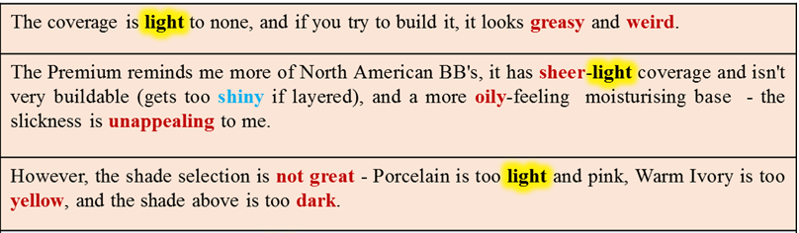
Domain-Polarity Adaptation
Basic Assumption
Each word could have different polarity in the same domain
Negative
Notes:
Percetual maps
To show the positions of products in comparison with those of competitors
To display only two dimensions of product features about some products
Radar chart
To display multiple dimensions of the products in one chart
To display a limited number of products in a chart

Slide 9
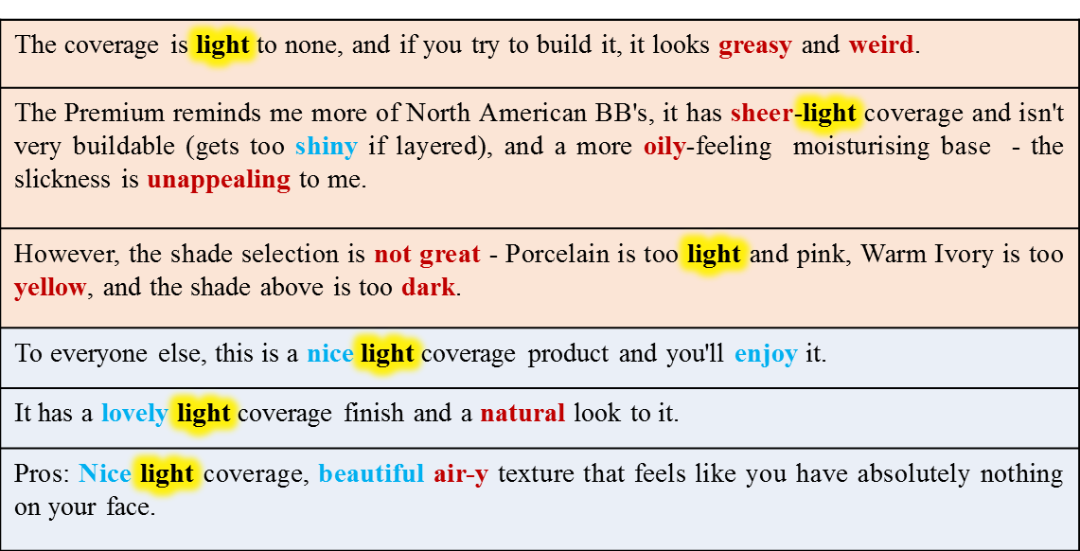
Domain-Polarity Adaptation
Basic Assumption
Each word could have different polarity in the same domain
Negative
Positive
Notes:
Percetual maps
To show the positions of products in comparison with those of competitors
To display only two dimensions of product features about some products
Radar chart
To display multiple dimensions of the products in one chart
To display a limited number of products in a chart

Slide 10
Domain-Polarity Adaptation
Positive set & Negative set
If rating = 5 then Positive set
If rating = 1 then Negative set
If sizes of two sets are not equal, Undersampling!
The sets of words
Generate the set of words appeared in each review set
Word Matrix
Word | Pos fq | Neg fq | Total fq | Pos % | Neg% | % Difference | POS | D_pol | S_pol | Agreement
like | 90 | 10 | 100 | 0.9 | 0.1 | 0.8 | v | Pos | Pos | Agree
shiny | 10 | 90 | 100 | 0.1 | 0.9 | 0.8 | a | Neg | Pos | Disagree
light | 40 | 60 | 100 | 0.4 | 0.6 | 0.2 | a | Neg | Pos | Disagree
⁞ | ⁞ | ⁞ | ⁞ | ⁞ | ⁞ | ⁞ |  | ⁞ | ⁞ | ⁞
Notes:
Percetual maps
To show the positions of products in comparison with those of competitors
To display only two dimensions of product features about some products
Radar chart
To display multiple dimensions of the products in one chart
To display a limited number of products in a chart

Slide 11
Domain-Polarity Adaptation
Ambiguity words
Proposed Algorithm
For word in word_matrix:
if Agreement == ‘Disagree’:
Ambiguity word
else:
if %Difference < Threshold:
Ambiguity word
else:
Senti_score(word) = SWN score
Word | Pos fq | Neg fq | Total fq | Pos % | Neg% | % Difference | POS | D_pol | S_pol | Agreement
like | 90 | 10 | 100 | 0.9 | 0.1 | 0.8 | v | Pos | Pos | Agree
shiny | 10 | 90 | 100 | 0.1 | 0.9 | 0.8 | a | Neg | Pos | Disagree
light | 40 | 60 | 100 | 0.4 | 0.6 | 0.2 | a | Neg | Pos | Disagree
Notes:
Percetual maps
To show the positions of products in comparison with those of competitors
To display only two dimensions of product features about some products
Radar chart
To display multiple dimensions of the products in one chart
To display a limited number of products in a chart

Slide 12
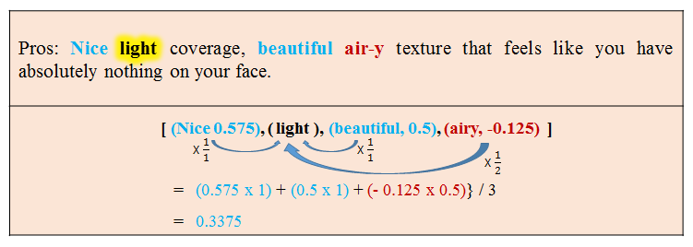

Domain-Polarity Adaptation
Assign Senti_score for Ambiguity words
Senti_score for Ambiguity words depends on neighbor words’ polarity
Common polarity could appear in one sentence
$Senti_score\left(Ambiguity word\right)=(\sum_{word∈sentence=1}^{n}{\frac{1}{distance\left(word, AW\right)}}Senti_score\left(word\right))÷n$
Notes:
Percetual maps
To show the positions of products in comparison with those of competitors
To display only two dimensions of product features about some products
Radar chart
To display multiple dimensions of the products in one chart
To display a limited number of products in a chart

Slide 13
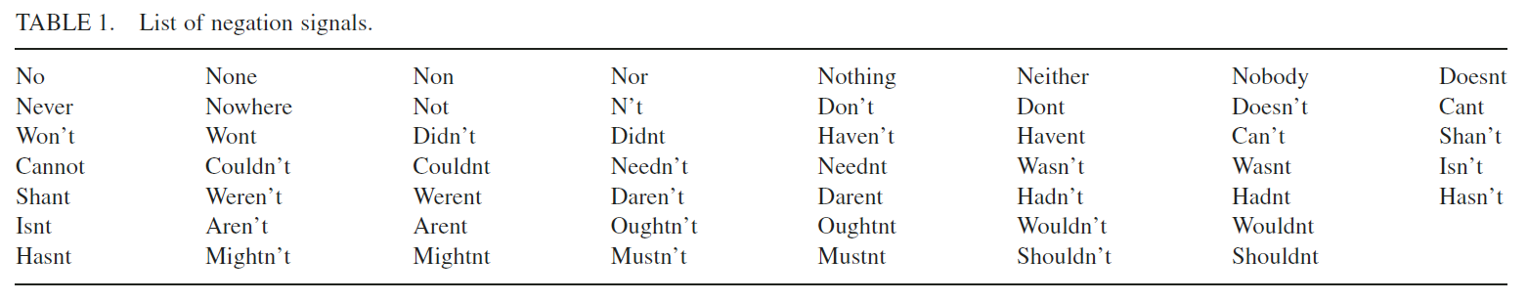
Negation & Intensifier
(Carrillo‐de‐Albornoz & Plaza, 2013)
(Hogenboom et al, 2013)
Negation treatment
If Negation appears, the Senti_score of following 2 words after negation is changed
Negated_Senti_score(word) = -1 * Senti_score(word)
Intensifier treatment
If Intensifier appears, the Senti_score of following 2 words after intensifer is changed
Intensified_Senti_score(word) = 2 * Senti_score(word)
'very', 'highly', 'strongly', 'significantly', 'extremely', 'absolutely', 'entirely', 'vastly', 'really', 'completely‘
Notes:
Percetual maps
To show the positions of products in comparison with those of competitors
To display only two dimensions of product features about some products
Radar chart
To display multiple dimensions of the products in one chart
To display a limited number of products in a chart

Slide 14

Sentiment score for Review
(Ganu, 2009)
Generate Sentiment score for review
As Rating sore is 1~5 points, we estimate that Senti_score is 1~5 points
$Senti_score(sentence)= \left[\frac{P}{P+N} ×4\right]+1$
$Senti_score\left(review\right)=(\sum_{sentence∈Review=1}^{n}{Senti_score(sentence)})÷n$
 | Rating-based | SentiWordNet | Domain-Polarity Adaption
Mean | 3.396705 | 3.582237 | 4.066075
Variance | 1.742406 | 0.505805 | 1.00359
Observations | 5392 | 5392 | 5392
Notes:
Percetual maps
To show the positions of products in comparison with those of competitors
To display only two dimensions of product features about some products
Radar chart
To display multiple dimensions of the products in one chart
To display a limited number of products in a chart

Slide 15
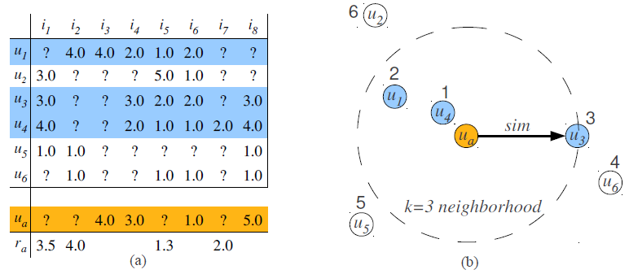
Experiments
(Hahsler, 2011)
User-based Collaborative Filtering
One of the popular Recommendation algorithms
Find K-nearest neighbors
Predict target users’ scores based on neighbors’ scores
Notes:
Percetual maps
To show the positions of products in comparison with those of competitors
To display only two dimensions of product features about some products
Radar chart
To display multiple dimensions of the products in one chart
To display a limited number of products in a chart

Slide 16
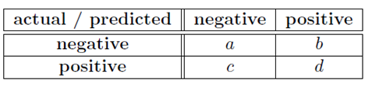
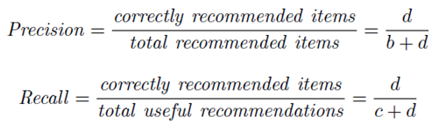
Experiments
(Hahsler, 2011)
Experimental settings
Threshold for Ambiguity words: 0.2
Similarity measure for CF: Cosine measure
# of Nearest Neighbors: 20
10-fold cross validation
Recommendation hits if validation set has any score
Evaluation measures
Notes:
Percetual maps
To show the positions of products in comparison with those of competitors
To display only two dimensions of product features about some products
Radar chart
To display multiple dimensions of the products in one chart
To display a limited number of products in a chart

Slide 17
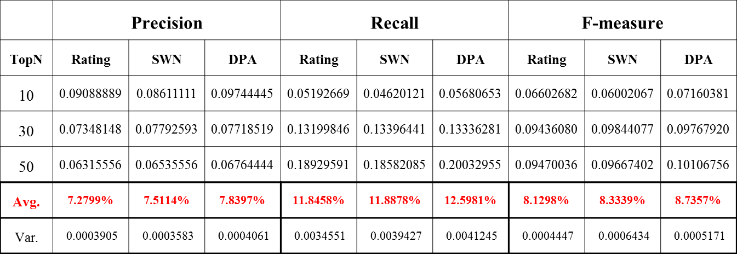
Experiments
Results
The Avg. of 10 experiments with TopN recommendation
Notes:
Percetual maps
To show the positions of products in comparison with those of competitors
To display only two dimensions of product features about some products
Radar chart
To display multiple dimensions of the products in one chart
To display a limited number of products in a chart

Slide 18
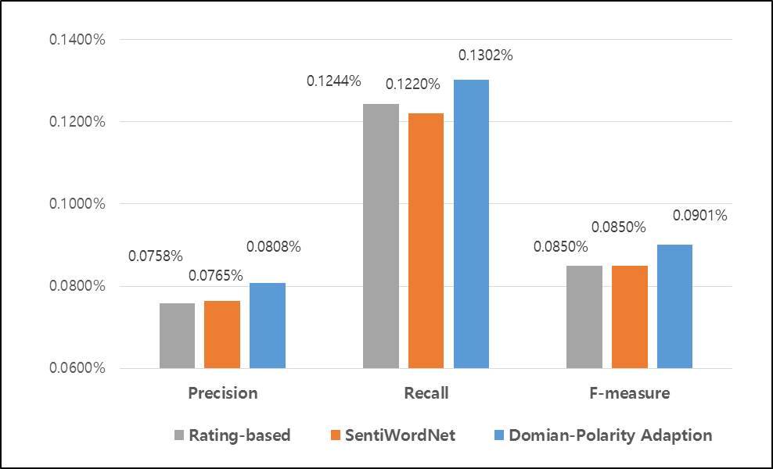
Experiments
Results
The Avg. of 10 experiments with TopN recommendation
Notes:
Percetual maps
To show the positions of products in comparison with those of competitors
To display only two dimensions of product features about some products
Radar chart
To display multiple dimensions of the products in one chart
To display a limited number of products in a chart

Slide 19

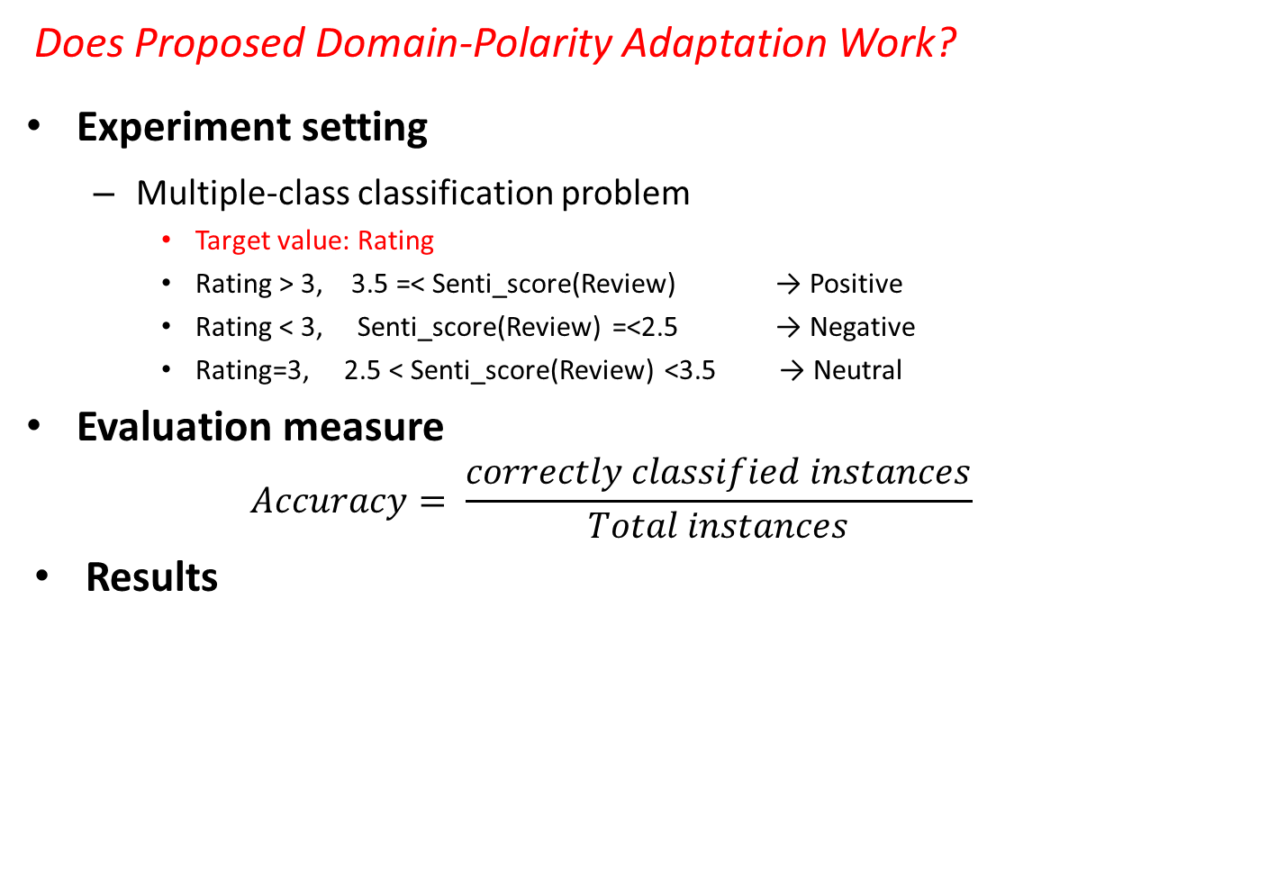
Additional Experiments
Does Proposed Domain-Polarity Adaptation Work?
Experiment setting
Multiple-class classification problem
Target value: Rating
Rating > 3, 3.5 =< Senti_score(Review) → Positive
Rating < 3, Senti_score(Review) =<2.5 → Negative
Rating=3, 2.5 < Senti_score(Review) <3.5 → Neutral
Evaluation measure
$$Accuracy= \frac{correctly classified instances}{Total instances}$$
Results
SentiWordNet | Domain-Polarity Adaptation
2767/5394 | 3083/5394
51.31% | 57.17%
Notes:
Percetual maps
To show the positions of products in comparison with those of competitors
To display only two dimensions of product features about some products
Radar chart
To display multiple dimensions of the products in one chart
To display a limited number of products in a chart

Slide 20

Conclusions
Contributions
Attempt to propose new framework for recommendation with review data
New approach for Domain-Polarity Adaptation
Limitations
Insignificantly improved performance of recommendation
Limited method for SentiWordNet
Limited method for calculating Review Senti_score
Notes:
Percetual maps
To show the positions of products in comparison with those of competitors
To display only two dimensions of product features about some products
Radar chart
To display multiple dimensions of the products in one chart
To display a limited number of products in a chart

Slide 21
References
Carrillo‐de‐Albornoz, J., & Plaza, L. (2013). An emotion‐based model of negation, intensifiers, and modality for polarity and intensity classification.Journal of the American Society for Information Science and Technology,64(8), 1618-1633.
Hogenboom, A., Van Iterson, P., Heerschop, B., Frasincar, F., & Kaymak, U. (2011, October). Determining negation scope and strength in sentiment analysis. In Systems, Man, and Cybernetics (SMC), 2011 IEEE International Conference on (pp. 2589-2594). IEEE.
Ganu, G., Elhadad, N., & Marian, A. (2009, June). Beyond the Stars: Improving Rating Predictions using Review Text Content. In WebDB (Vol. 9, pp. 1-6).
Hahsler, M. (2011). recommenderlab: A Framework for Developing and Testing Recommendation Algorithms. Nov.
Notes:
Percetual maps
To show the positions of products in comparison with those of competitors
To display only two dimensions of product features about some products
Radar chart
To display multiple dimensions of the products in one chart
To display a limited number of products in a chart

Slide 22
Thank you
Do you have any questions?

